Slide 1
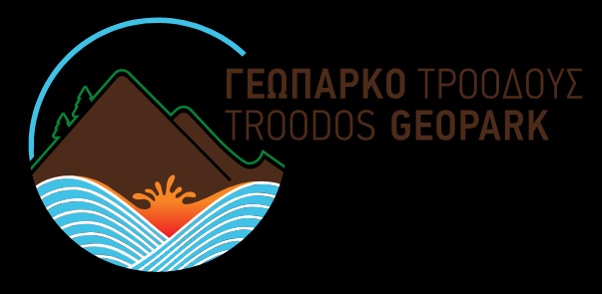
Troodos Geopark: A historical review of Cyprus
Group 2 : Desislava vasileva
Radostina markova
maria kozakoy
adelina papapetroy

Slide 2
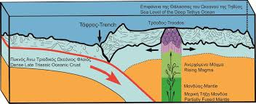
How Troodos came to the surface?
Cyprus was formed as a result of a series of unique events which has made the island a geological show case.
About 90 million years ago, Cyprus was part of the bottom of a deep ocean, called Tethys.
Tectonic movements at that time resulted in the collision of the African with the Eurasian plate, ultimately giving birth to the island.
The Troodos Massif itself first rose above the ocean around 20 million years ago along with its smaller sister in the north of the island, the Pentadactylos range.

Slide 3
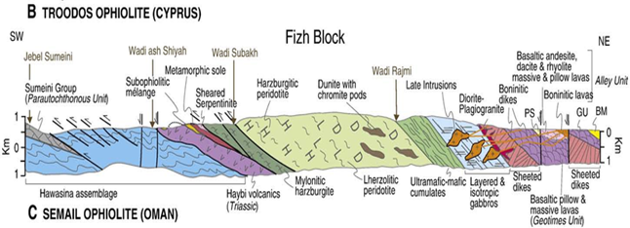
Ophiolite
The Troodos mountain range is an ophiolite, a term used to describe a group of igneous rocks which make up the oceanic crust. Troodos is part of a very ancient section of oceanic crust which was uplifted to its present position due to the collision of the African and Eurasian Tectonic Plates and the subduction of the former beneath the latter. It is considered the most complete and best-studied ophiolite in the world.
On Troodos one finds all the groups of ophiolite rocks, consisting of the following stratigraphic units, in ascending order:
(a) Mantle sequence and cumulates
(b) Plutonic rocks
(c) Intrusives
(d) Volcanics and pillow lava flows
(e) Chemical sediments such as umber

Slide 4
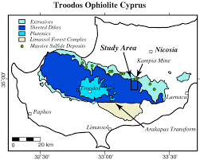
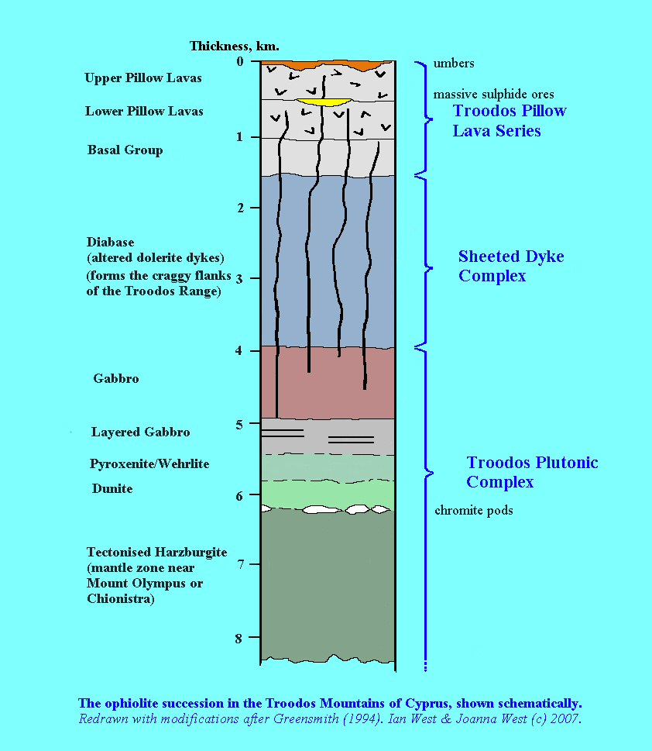
video

Slide 5
THANK YOU

